Slide 1

1,024 × 546

Slide 2
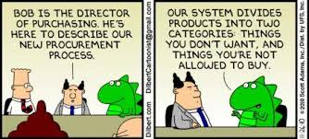

Slide 3
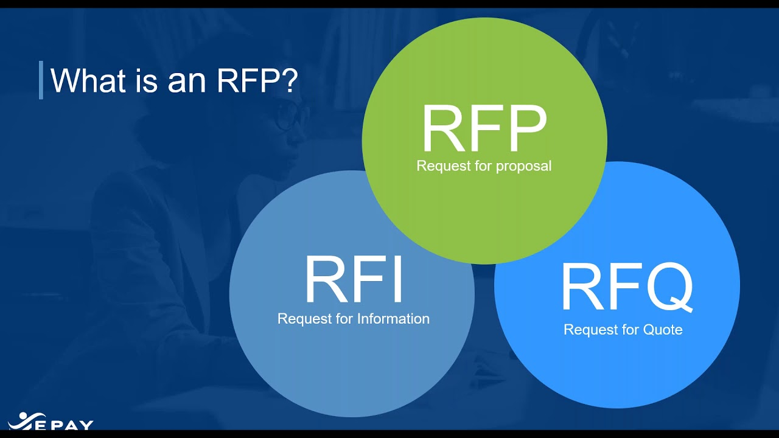
1,280 × 720

Slide 4

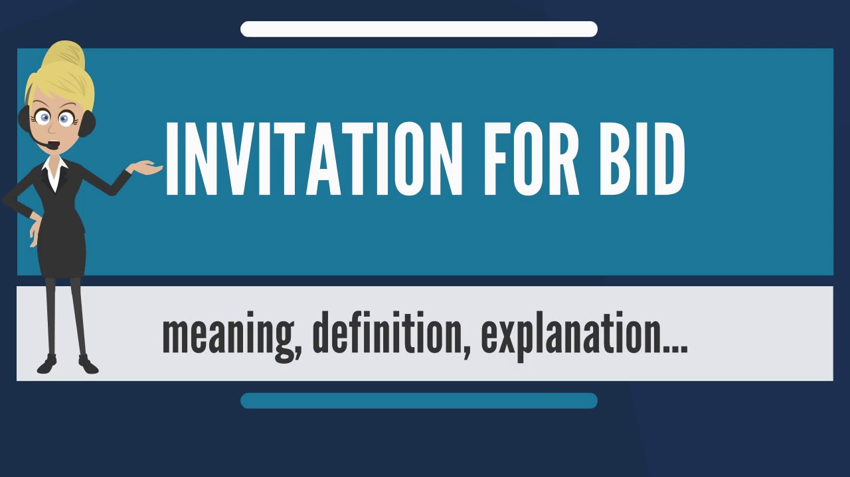
1,280 × 720

Slide 5
What Value??
IFB
  Lowest cost
  Good Value
RFP
  Not always lowest cost
  Best Value

Slide 6
The Process - Documents
IFB
  Instructions
  General Conditions
  Special Conditions
  Specifications
  Bid Form
RFP
  Instructions
  General Conditions
  Special Conditions
  Scope of Work
  Sample Contract
  Evaluation Criteria
Notes:
SAME BUT DIFFERENT

Slide 7
Specifications
IFB
  Specific, minimum requirements for performance or design. Telling exactly what you want.
RFP
  The results are determined by the Scope of Work. Asking for someone to develop and provide a solution

Slide 8
Evaluations
IFB
  Must meet specs
  Lowest Responsive and Responsible Bidder
  No changes allowed
RFP
  Must meet minimum requirements
  Criteria evaluated and scored
  Awarded to high score

Slide 9

Discussions
RFP
  Individual discussions with proposors to better understand
IFB
  None
Notes:
CAN HAVE A FORMAL PRESENTATION IF NEEDED

Slide 10
Formal bid procedure for governing authorities
Write terms, conditions, instructions, Specifications
Advertise once each week for two consecutive weeks, open bid not less than 7 working days after the last advertisement.
Solicit bids
Notify the Contract Procurement Center
Receive and tabulate bids, determine the lowest and best bid meeting specifications
Obtain proper board approvals and make purchase

Slide 11
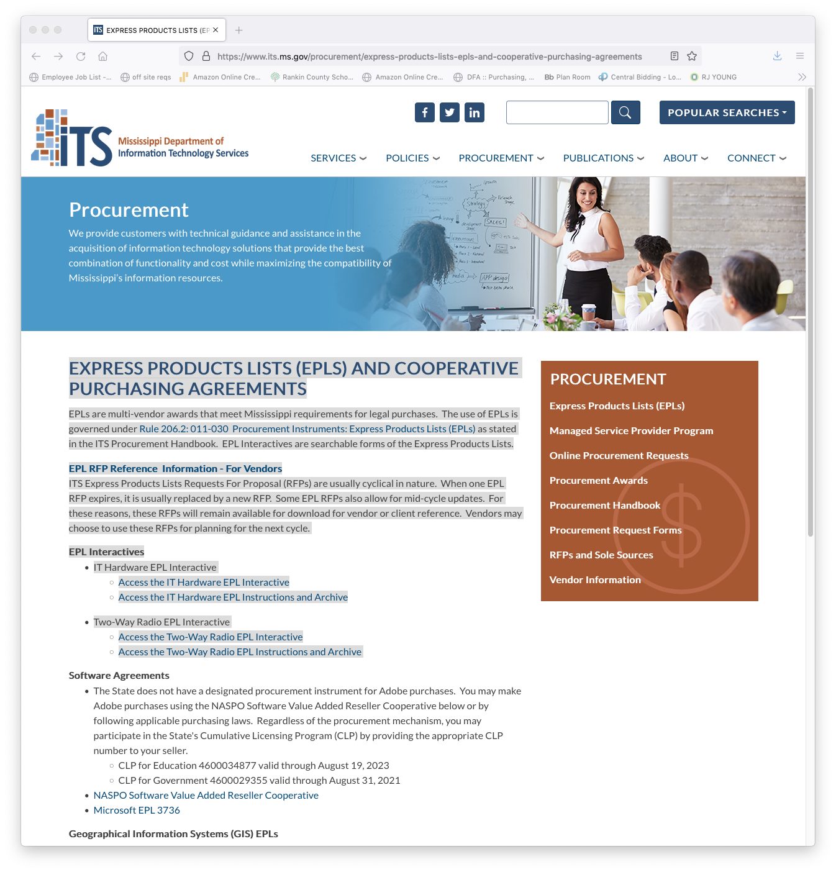
EPL—EXPRESS PRODUCTS LIST
HARDWARE--MOST USED
2 WAY RADIO
SOFTWARE
GIS
OTHERS

Slide 12


DO YOU HAVE TO HAVE TWO QUOTES IF YOU ARE USING THE EPL????
YES
NO

Slide 13



Slide 15


Slide 16
STATE CONTRACTS

Slide 17
QUESTION????
DO WE AS SCHOOL DISTRICTS HAVE TO USE COMPETITIVE BID STATE CONTRACT?

Slide 18

Competitive Bid Contracts
What items are they used for?
How are they developed?
Who can use them?
Who must use them?

Slide 19
QUESTION????
DO WE AS SCHOOL DISTRICTS HAVE TO USE NEGOTIATED STATE CONTRACT?

Slide 20
NEGOTIATED State Contracts
MULTIPLE AWARD
What items are they used for?
How are they developed?
Who can use them?
Who must use them?

Slide 21
QUESTION????
IS AN AGENCY CONTRACT ONLY FOR AGENCIES OF THE STATE?

Slide 22
Statewide Agency Contracts
What items are they used for?
How are they developed?
Who can use them?
Who must use them?

Slide 23
QUESTION????
I CAN USE ANY COOPERATIVE CONTRACT RIGHT?????

Slide 24


COOPERATIVE CONTRACTS
What items are they used for?
How are they developed?
Who can use them?
Who must use them?

Slide 25



ATHLETIC EQUIPMENT AND UNIFORMS
BUILDERS’ SUPPLIES
EDUCATIONAL MATERIALS
OFFICE SUPPLIES

Slide 26
CURRENT LEGISLATION
HB 1173
REVERSE AUCTION REVISE
SB 2371
REVISE THRESHOLD TO $75,000
HB 1475
REVERSE AUCTION REVISE
SB 2800
REVERSE AUCTION REVISE
HB 1477
REVERSE AUCTION REVISE
SB 2806
REVERSE AUCTION REVISE

Slide 27
Procurement Card Program
Reduced administrative costs
Increased efficiency
Controls
Proper training and monitoring REQUIRED!!!
This is a great tool when used properly!

Slide 28
Purchasing of fuel
State contract with Fuelman
  31-7-13(q)
  www.dfa.state.ms.us click on statewide purchasing, state contracts, fuel access card
Bid for annual contract
  31-7-13(h)
Get quotes as needed
  31-7-13(h)

Slide 29
Types of Specifications
Brand name
Brand name or equal
Qualified Products List
Market Grade/Industry standard
Design
Performance
Combination

Slide 30
How to write specifications
Consult users, vendors, etc
Contact other entities
Collect information
Review documentation
Develop draft specifications
Get feedback
Revise

